Slide 1

Software Engineering (SE)
# 2101CS503
Lab -2
Practical - 1 Use case Diagram
Prof. Ekta A. Baldha
Computer Science & Engineering Department
Ekta.baldha@darshan.ac.in

Slide 2
Use Case Diagram
A use case diagram is a representation of a user's interaction with the system.
This interaction shows the relationship between the user and the different use cases in which the user is involved.
The purpose of the use case diagrams is simply to provide a high-level view of the system and convey the requirements in layman's terms for the stakeholders.

Slide 3

Components of Use Case diagram
System boundary
Use case
Represent the scope of the system
Use cases of the system are placed inside the system boundary
Actors who interact with the system are placed outside the system
A use case represents a user goal / piece of functionality that can be achieved by accessing the system or software application.
Use
Cases
Actor
Association
An actor is an entity that interacts directly with the system but that is not part of system
Actor may be people, computer hardware, other systems, etc.
An actor and use case can be associated to indicate that the actor participates in that use case

Slide 4
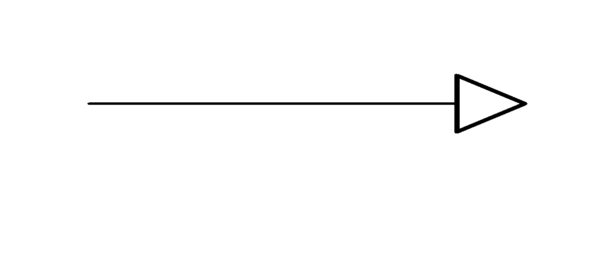
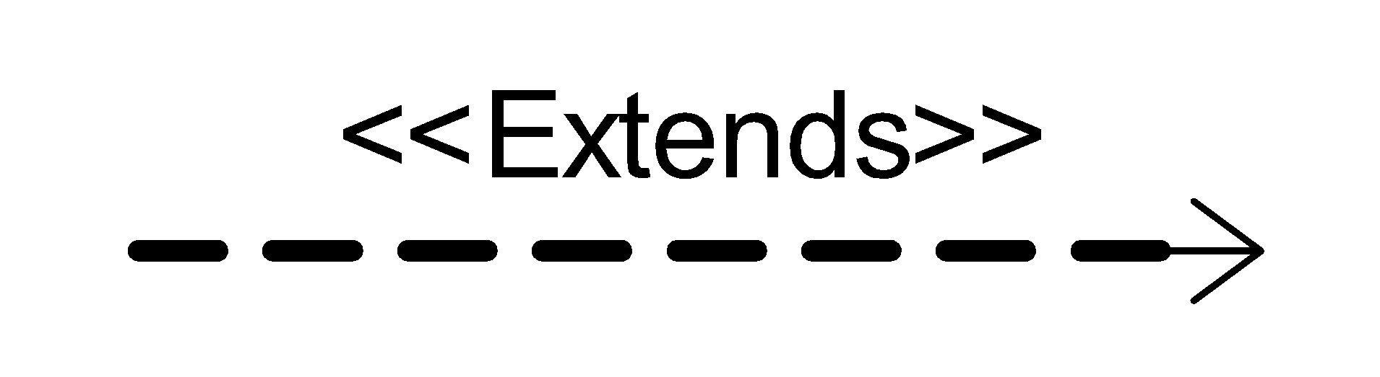
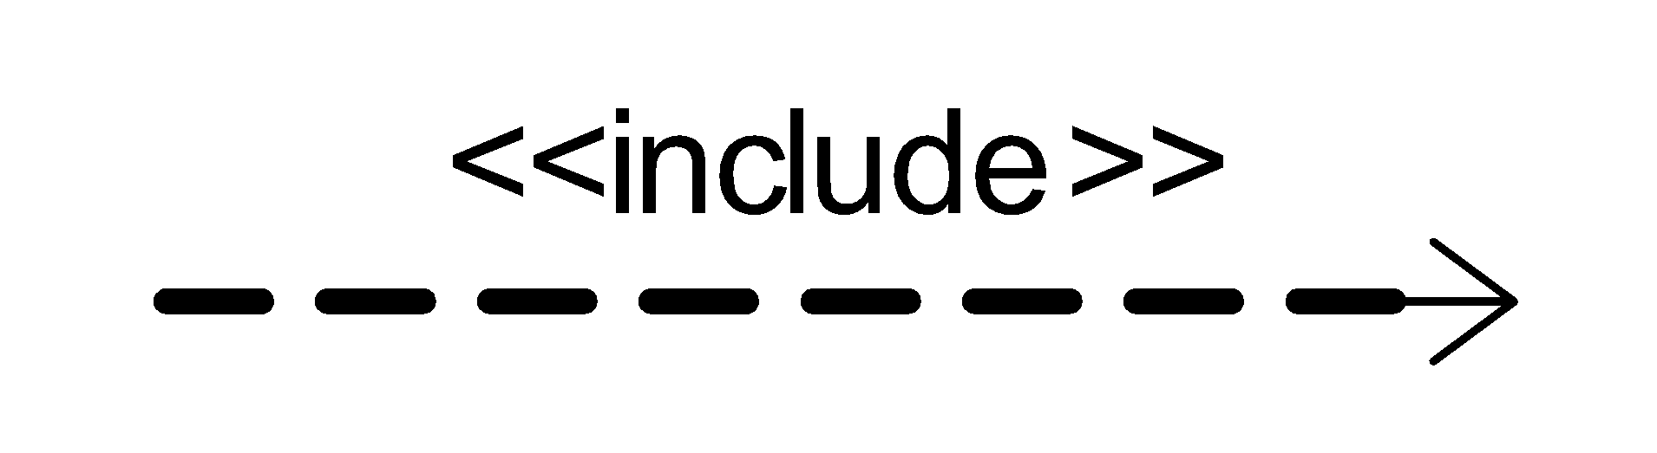
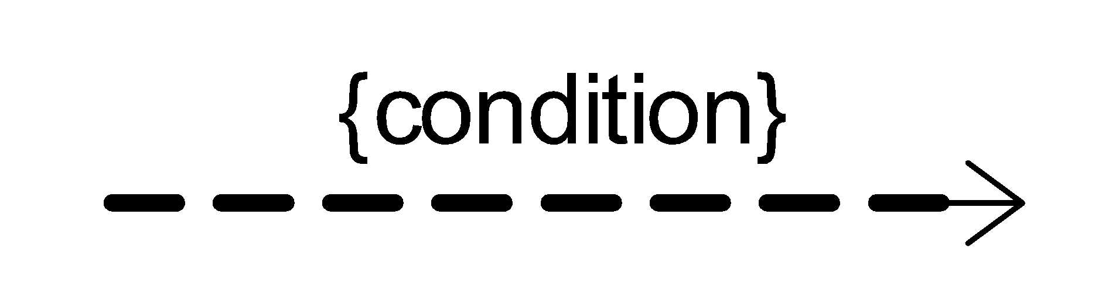
Components of Use Case diagram Cont.
Generalization
Extends
A generalization relationship is used to represent the inheritance relationship between model elements of the same type
The extend relationship specifies that the incorporation of the extension use case is dependent on what happens when the base use case executes.
Include
Constraint
An include relationship is a relationship in which one use case includes the functionality of another use case
The include relationship supports the reuse of functionality in a use-case model.
Show condition exists between actors and activity

Slide 5
Example of Extends and Include
Includes
Check Order Status
In e-commerce application that provides customers with the option of checking the status of their orders. For checking the status of their order user should be login.
This behavior is modeled with a base use case called CheckOrderStatus that has an inclusion use case called Login.
<<include>>
Login
Extends
pay for item
In e-commerce site, When paying for an item, you may choose to pay on delivery, pay using Pay by UPI, or pay by card.
These are all alternatives to the "pay for item" use case. I may choose any of these options depending on my preference.
<<extend>>
<<extend>>
pay by card
pay by UPI

Slide 6
Guideline for constructing use case diagram
Determine the system boundary.
Ensure that actors are focused, each actor should have a single, coherent purpose. If a real world object contains multiple purpose, capture them with separate actors
Each use case must provide value of users
Relate use cases and actors

Slide 7
Identify the Functionality & Stakeholders for LMS
Functionality
Stakeholders
Register User
Add Article
Update Article
Delete Article
Inquiry Members
Inquiry Issuance
Check out Article
Check in Article
Reserve Article
Set user Permission
Search Article
Check Account
Prepare Library Database
Librarian
Member
Guest

Slide 8
Relationship Between Functionality & Stakeholders
Register user
Add Article
Update Article
Delete Article
Inquiry Members
Inquiry Issuance
Check out Article
Check in Article
Set user Permission
Request for registration
Guest
Librarian
Reserve Article
Search Article
Check Account
Member

Slide 9
Use Case Diagram Library Management
Library Management System
1. Login
10. Request registration
2. Register user
<<extend>>
.3. Manage member permission
12. Display Error Message
Guest
4. Add Article
11. Check account
5. Delete Article
6. Inquiry article
13.Search by title
Member
<<include>>
7. Inquiry member
12. Search article
Librarian
8. Check in articles
<<include>>
9. Check out articles
14 Search by publication
Student
Staff

Slide 10
Usage Scenarios & Story Writing
Scenarios are created by user researchers to help communicate with the design team.
User stories are created by project/product managers to define the requirements prior to a sprint in agile development.
Scenarios are stories that capture a goal, motivations, and tasks of a person in a given system.
User stories provide a rapid way of handling customer requirements instead of formal requirement documents
Gherkin language is used to write an effective story of the system requirement.
Gherkin is a human-readable language for system behavior description, which uses indentation to define the structure of the document.
Each line starts with one of the keywords and describes one of the steps.
Refer to Gherkin Syntax for story writing (For more details refer to this link: https://www.guru99.com/gherkin-test-cucumber.html).

Slide 11
Login Usage Scenarios and Story
Feature | Login
Scenario | User Login with valid username and password
Prerequisite | User must have proper client installed on user terminal.
Story | Given: User navigated to the Login Screen. When: User enters the correct User Name. And the user enters the correct password. And user Click “login” button. Then: System verify user information. display dashboard of user. display username on top of the right side. display logout button.

Slide 12
Login Usage Scenarios and Story
Feature | Login
Scenario | User Login with invalid username and password
Prerequisite | User must have proper client installed on user terminal.
Story | Given: User navigated to the Login Screen. When: User enters the wrong User Name. And the user enters the wrong password. And user Click “login” button. Then: System verify user information. display error message for invalid username and password.

Slide 13

Software Engineering (SE)
# 2101CS503
Prof. Ekta A. Baldha
Computer science & Engineering Department
Ekta.baldha@darshan.ac.in

